Slide 1
Medicare: Part D
Health Insurance?
Notes:
Focus: Gender Disparity
And if there is?
Since it is going to be hard to have universal rate –
How can this disparity help instead – based on the location, the service need/ claim. Example:
People living in Cali, suffering for x, should go to female provider and chances are they would be charged less compared to male. Additional: Who can effectively use the “cheatsheet” which state? Which claim type?

Slide 2

Health Insurance?
Notes:
What is the first thing that we think of when we hear Health Insurance?
Aside from it being requirement here as an IS, an additional cost, something that was cut out from out salaries. And No. we’re not here to offer more insurance
So
What is it?
Health insurance is basically a financial arrangement that helps cover the cost of medical expenses.
Now that we know what health insurance is, let's delve into the single largest payer in the US.

Slide 3
Medicare? Part huh?
Part A
Part B
Part C
Part D
Hospital Insurance
Hospital
Nursing Services
Medical Insurance
Outpatient Services
Medical Equipment
Semi – All in one
Some Part A +Some Part B coverage
Prescription drugs
coverage
(Self administered)
Notes:
Medicare is a federal health insurance program designed for people aged 65 and older, as well as younger individuals with certain disabilities.

Slide 4
Part A
Part B
Part C
Part D
Hospital Insurance
Hospital
Nursing Services
Medical Insurance
Outpatient Services
Medical Equipment
Semi – All in one
Some Part A +Some Part B coverage
Prescription drugs
coverage
(Self administered)

Slide 5
Part A
Part B
Part C
Part D
Hospital Insurance
Hospital
Nursing Services
Medical Insurance
Outpatient Services
Medical Equipment
Semi – All in one
Some Part A +Some Part B coverage
Prescription drugs
coverage
(Self administered)
Sample Size
50,000
# of Features
26
Categorical Variables
18
Numerical Variable
8
Variable/s of interest
Gender
Avg. Charge Amount
Procedure

Slide 6
Part D
Part A
Part B
Part C
Hospital Insurance
Hospital
Nursing Services
Medical Insurance
Outpatient Services
Medical Equipment
Semi – All in one
Some Part A +Some Part B coverage
Prescription drugs
coverage
(Self administered)
Sample Size
50,000
# of Features
26
Categorical Variables
18
Numerical Variable
8
Variable/s of interest
Gender
Avg. Charge Amount
Procedure
Notes:
Dataset is about prescription drugs coverage (Self administered)
How much does medicare cover, how much do providers charge, Services per day,etc
Sample Size: 50k rows composed of 26 features where 18 of those are categorical and the remaining 8 are numerical
Lastly, our variables of interest: Gender, Avg. Charge Amount, and Location
But why is our Variable of interest?
Gender
Avg. Charge Amount
#Location

Slide 7
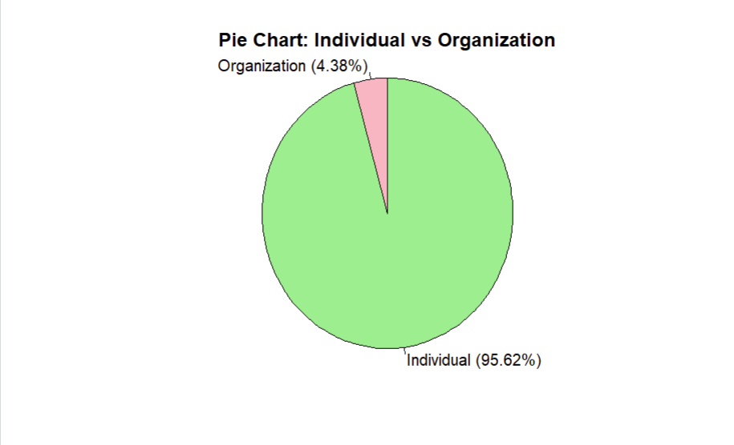
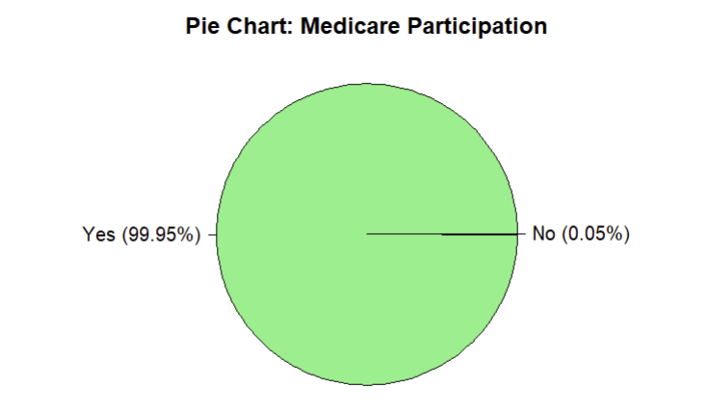
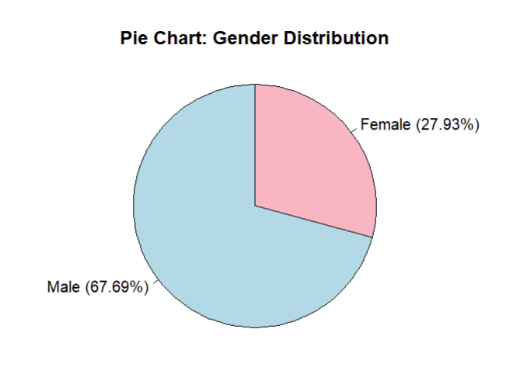
Dataset Breakdown
Do female medical providers charge less?
Notes:
Let’s first check if the sample size is even accepting Medicare – 0.05% (only 25 is not!)
Extremely small that either we include or not would not affect the analysis at all

Slide 8
Dataset Breakdown
Do female medical providers charge less?
Notes:
Next, Let’s check the individual vs organization medical providers:
Our dataset is composed of 99.62% individuals

Slide 9
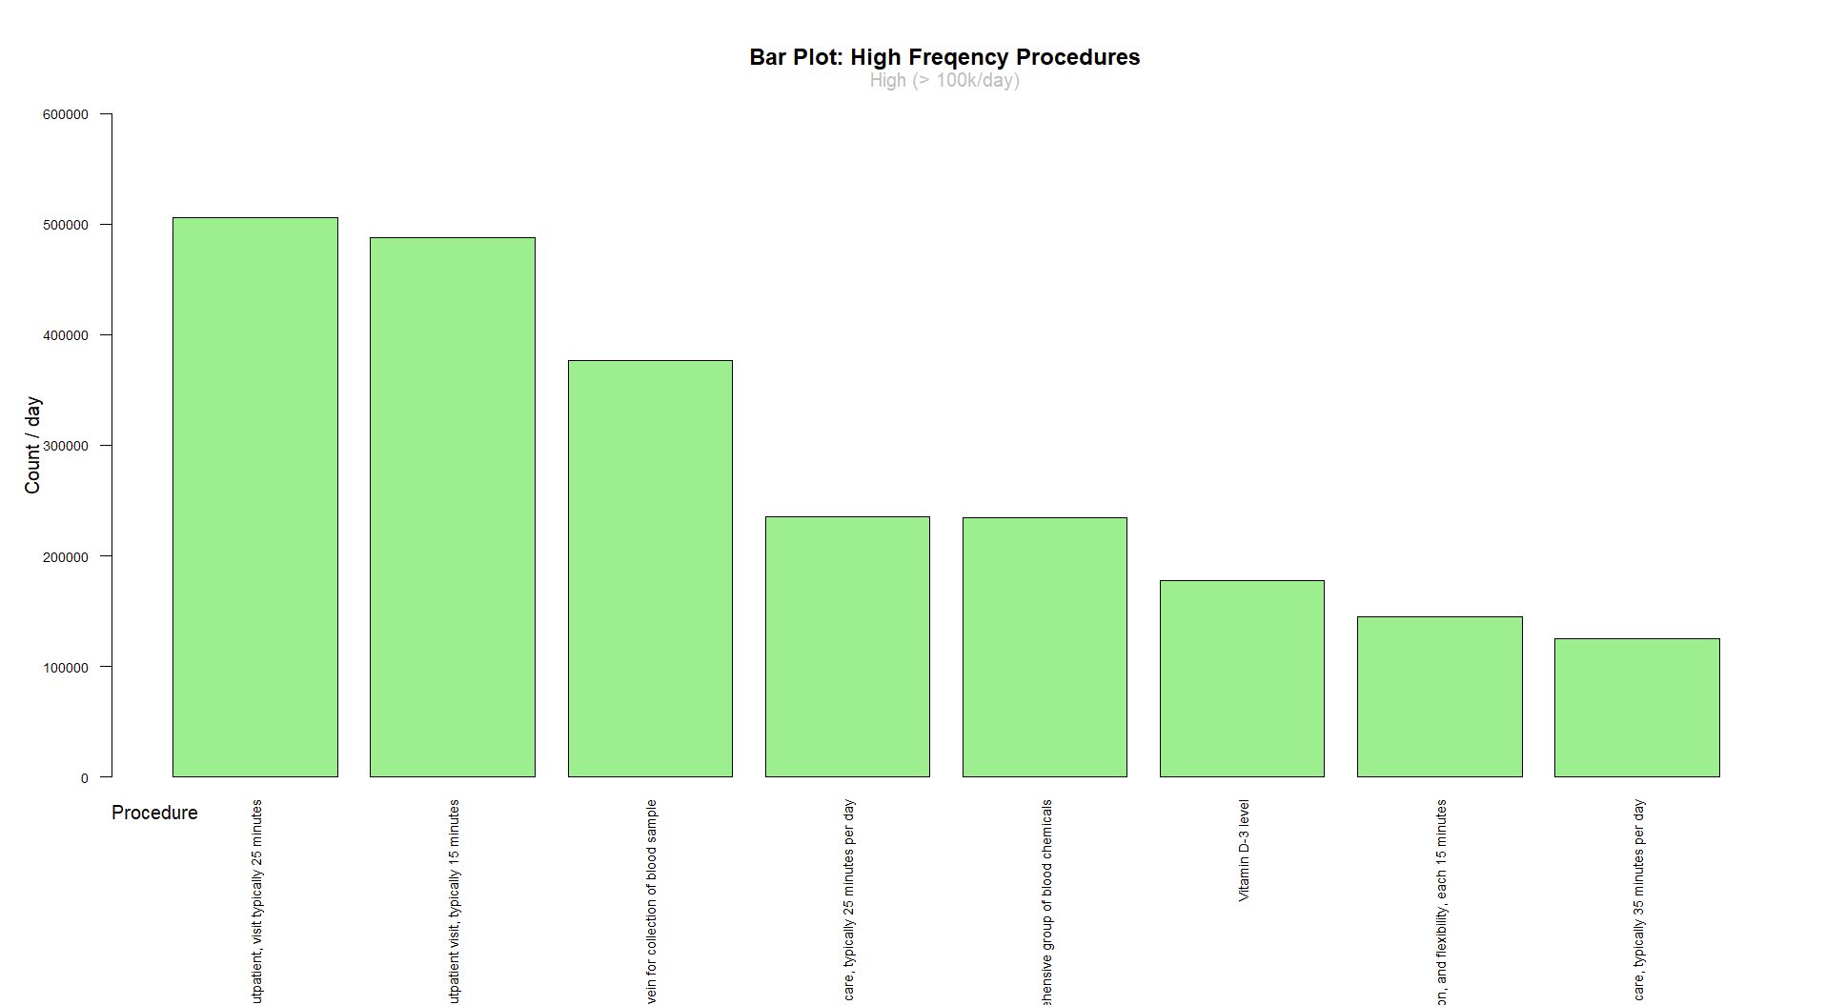
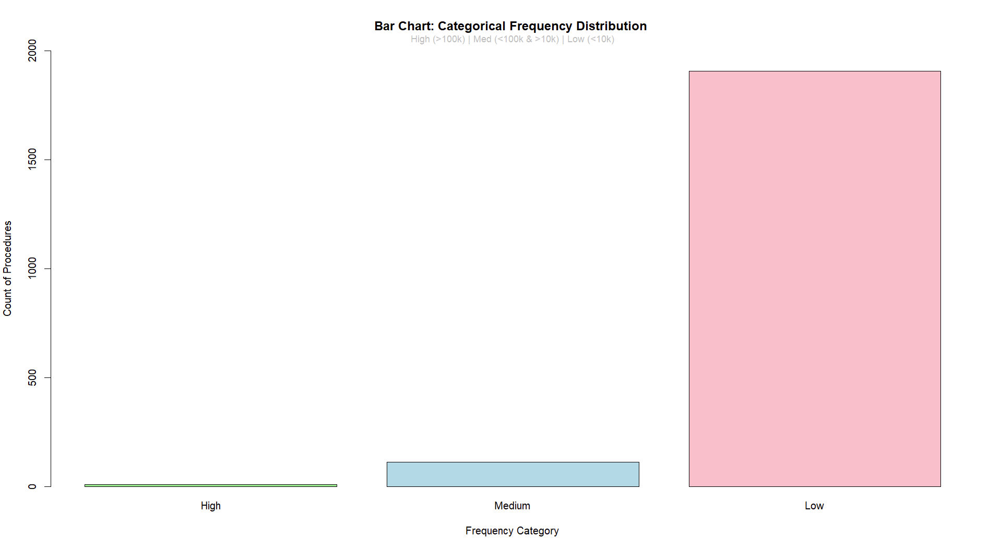

Do female medical providers charge less?
Notes:
Out of the 50,000 rows, we summarized the procedures into 2029 unique procedures.
Categorized them into High, Medium, and Low Frequency.

Slide 10
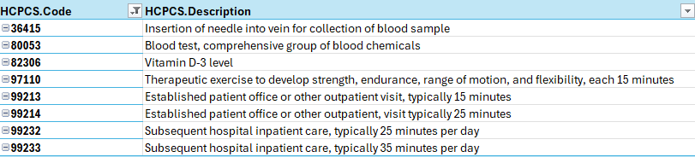
Do female medical providers charge less?
Notes:
36415 Insertion of needle into vein for collection of blood sample
80053 Blood test, comprehensive group of blood chemicals
82306 Vitamin D-3 level
97110 Therapeutic exercise to develop strength, endurance, range of motion, and flexibility, each 15 minutes
99213 Established patient office or other outpatient visit, typically 15 minutes
99214 Established patient office or other outpatient, visit typically 25 minutes
99232 Subsequent hospital inpatient care, typically 25 minutes per day
99233 Subsequent hospital inpatient care, typically 35 minutes per day

Slide 11
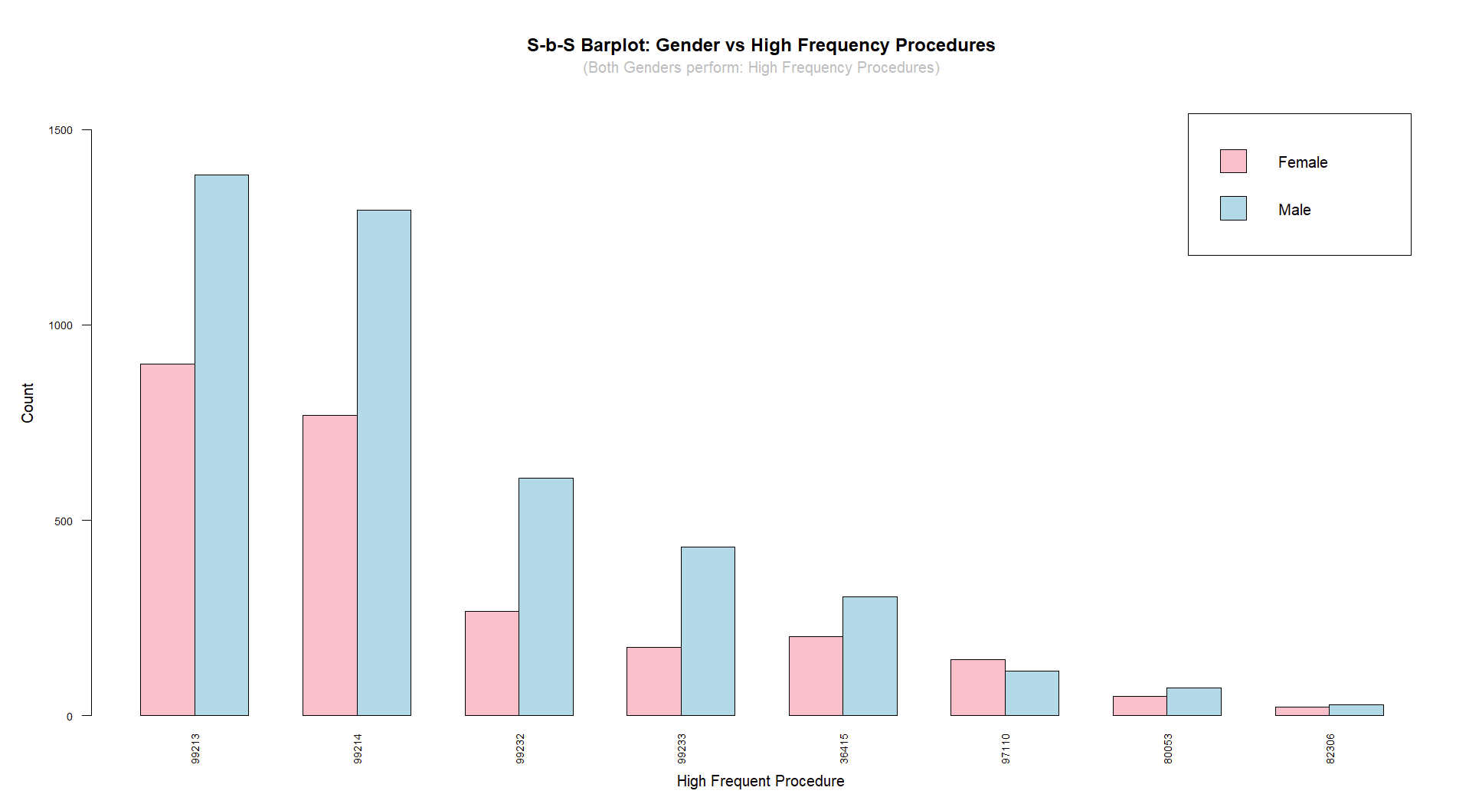
Do female medical providers charge less?
χ2 = 79.8
Notes:
The computed chi-square statistics is 79.818 and visually shows that the two variables are not independent.

Slide 12
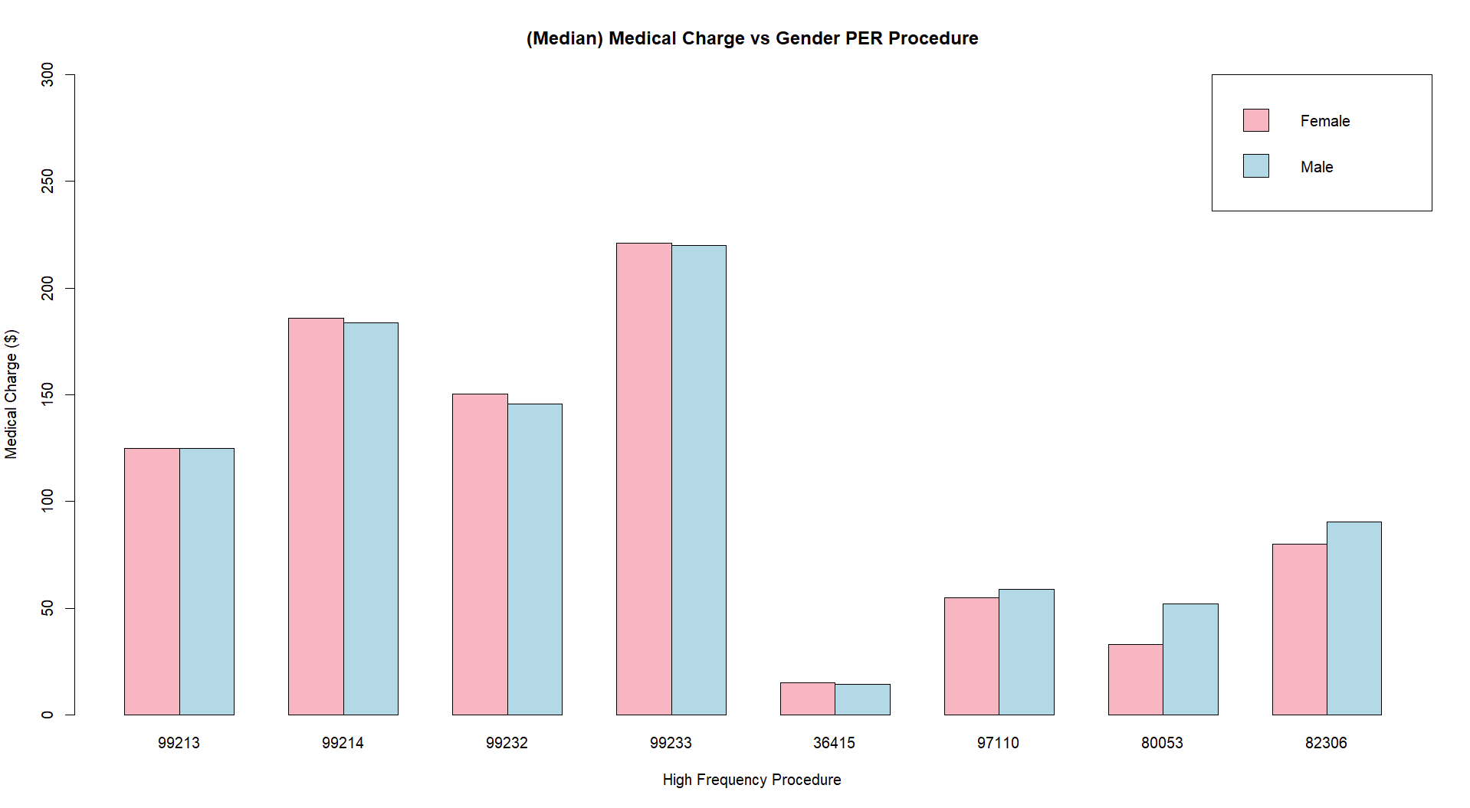

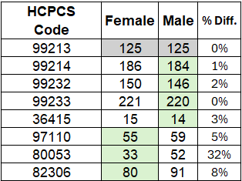

Do female medical providers charge less?
221
220
186
184
150
146
125
91
80
55
59
52
33
15
14
Notes:
When using median: Here is the result!
Females Charge more on 4 out of 8 high frequency procedures but not that much
Males Charge less on 3 out of 8 high frequency procedures and the difference is rather significant versus Female
One Cat: Gender
One Cat (secondary): Procedure
One Num: Median of Average Submitted Medical Charges.
Final: One Cat vs One Num

Slide 13
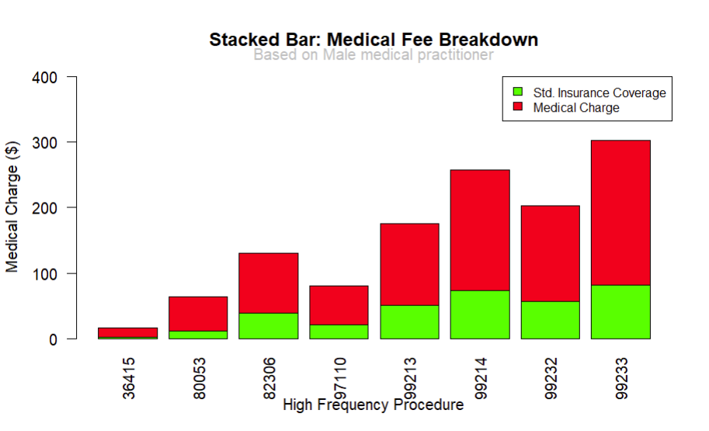
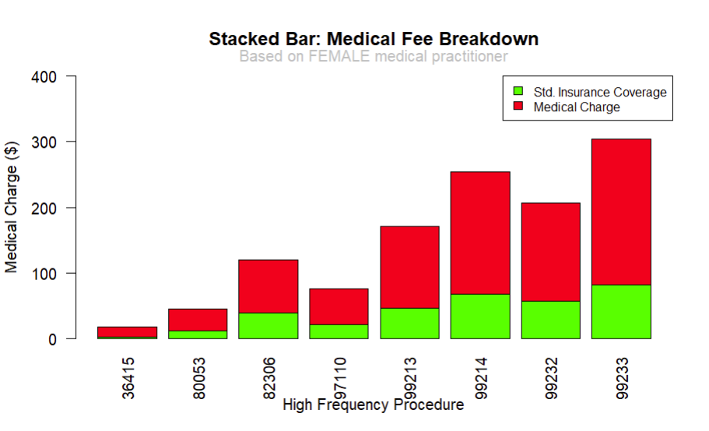
Do female medical providers charge less?
Beneficiaries’ Medical Fee Breakdown
Notes:
This is how usually our medical fees break down in simple terms.
Medical Charge minus the Insurance Coverage = Remaining Balance a patient to be paid out of pocket.
We can see significant difference between the medical fees of a patient when they go to a Male medical practioner

Slide 14

Do female medical providers charge less?
They charge LESS than their male counterparts!
HOWEVER, based on 4 of the 8 high frequency procedures, they charge more but rather insignificant.
Male practitioners charge significantly more on 3 of the 8 high.
Notes:
Summary:
The analysis of submitted charge amounts across 8 procedures indicates that female medical practitioners generally charge less than their male counterparts.
However, the results show that in 4 out of the 8 procedures, female practitioners actually charge marginally more, with the difference being relatively small.
On the other hand, male practitioners tend to charge significantly more in 3 out of the 8 procedures, which highlights noticeable disparities in those cases.
While this data does not conclusively show that female practitioners consistently charge less, it suggests that male practitioners tend to have higher charges in cases where there is a substantial difference.“ What is

Slide 15
Next Action/s:
Who is this EDA for?
Medicare.gov
Beneficiaries
Policy adjustments to reduce these types of discrepancies.
Opportunity to standardize rates more effectively.
Optimize reimbursement models.
More informed decisions when on a tight budget.
Advocate for fair billing.
Explore alternatives w/o sacrificing quality.
Map out where the procedures are done and where those “female practitioners” are typically located.
Explore the medium and low frequency procedures.
Check if credentials affect the medical charge amount.
Re-do the study based on procedure difficulty instead of frequency.
Notes:
Limitations of the study:
The credentials of the provider – provider may charge more for the same procedure based on their credential, their “quality” of facility, equipment etc.
Location of the provider – location

Slide 16
Empathy
“Empathy is a complex capability enabling individuals to understand and feel the emotional states of others, resulting in compassionate behavior”
-Riess, Helen, MD. (2017)
compassionate behavior
Notes:
<back-up slide not part of presentation> Build up:
Insert how biologically females are more empathic – source: https://www.ncbi.nlm.nih.gov/pmc/articles/PMC5110041/
The Science of Empathy – source: https://www.ncbi.nlm.nih.gov/pmc/articles/PMC5513638/
Let’s first talk about Empathy – Empathy is a capability of individuals resulting in compassionate behavior
And study suggests that males express less empathy.
If empthatic – possible lower charges
If not empathic – normal charge or higher charge
With that said:
Which of the genders charge less?

Slide 17
A study suggests that:
“Empathy is a complex capability enabling individuals to understand and feel the emotional states of others, resulting in compassionate behavior”
-Riess, Helen, MD. (2017)
“Especially in adulthood it seems that males vary more than females in some aspects of emotional processing and altruistic behavior, suggesting that even though it appears that males express less empathy”
-Christov-Moore et al. (2014)
males express less empathy
Empathy
compassionate behavior
Notes:
<back-up slide not part of presentation> Build up:
Insert how biologically females are more empathic – source: https://www.ncbi.nlm.nih.gov/pmc/articles/PMC5110041/
The Science of Empathy – source: https://www.ncbi.nlm.nih.gov/pmc/articles/PMC5513638/
Let’s first talk about Empathy – Empathy is a capability of individuals resulting in compassionate behavior.
And in from numerous studies, it suggests that males express less empathy.
With that said:
Do female medical providers charge less?
If empthatic – possible lower charges
If not empathic – normal charge or higher charge

Slide 18
A study suggests that:
“Empathy is a complex capability enabling individuals to understand and feel the emotional states of others, resulting in compassionate behavior”
-Riess, Helen, MD. (2017)
“Especially in adulthood it seems that males vary more than females in some aspects of emotional processing and altruistic behavior, suggesting that even though it appears that males express less empathy”
-Christov-Moore et al. (2014)
Empathy
compassionate behavior
males express less empathy
So…
Do female medical providers charge less?
Notes:
<back-up slide not part of presentation> Build up:
Insert how biologically females are more empathic – source: https://www.ncbi.nlm.nih.gov/pmc/articles/PMC5110041/
The Science of Empathy – source: https://www.ncbi.nlm.nih.gov/pmc/articles/PMC5513638/
Let’s first talk about Empathy – Empathy is a capability of individuals resulting in compassionate behavior
And study suggests that males express less empathy.
If empthatic – possible lower charges
If not empathic – normal charge or higher charge
With that said:
Which of the genders charge less?

Slide 19
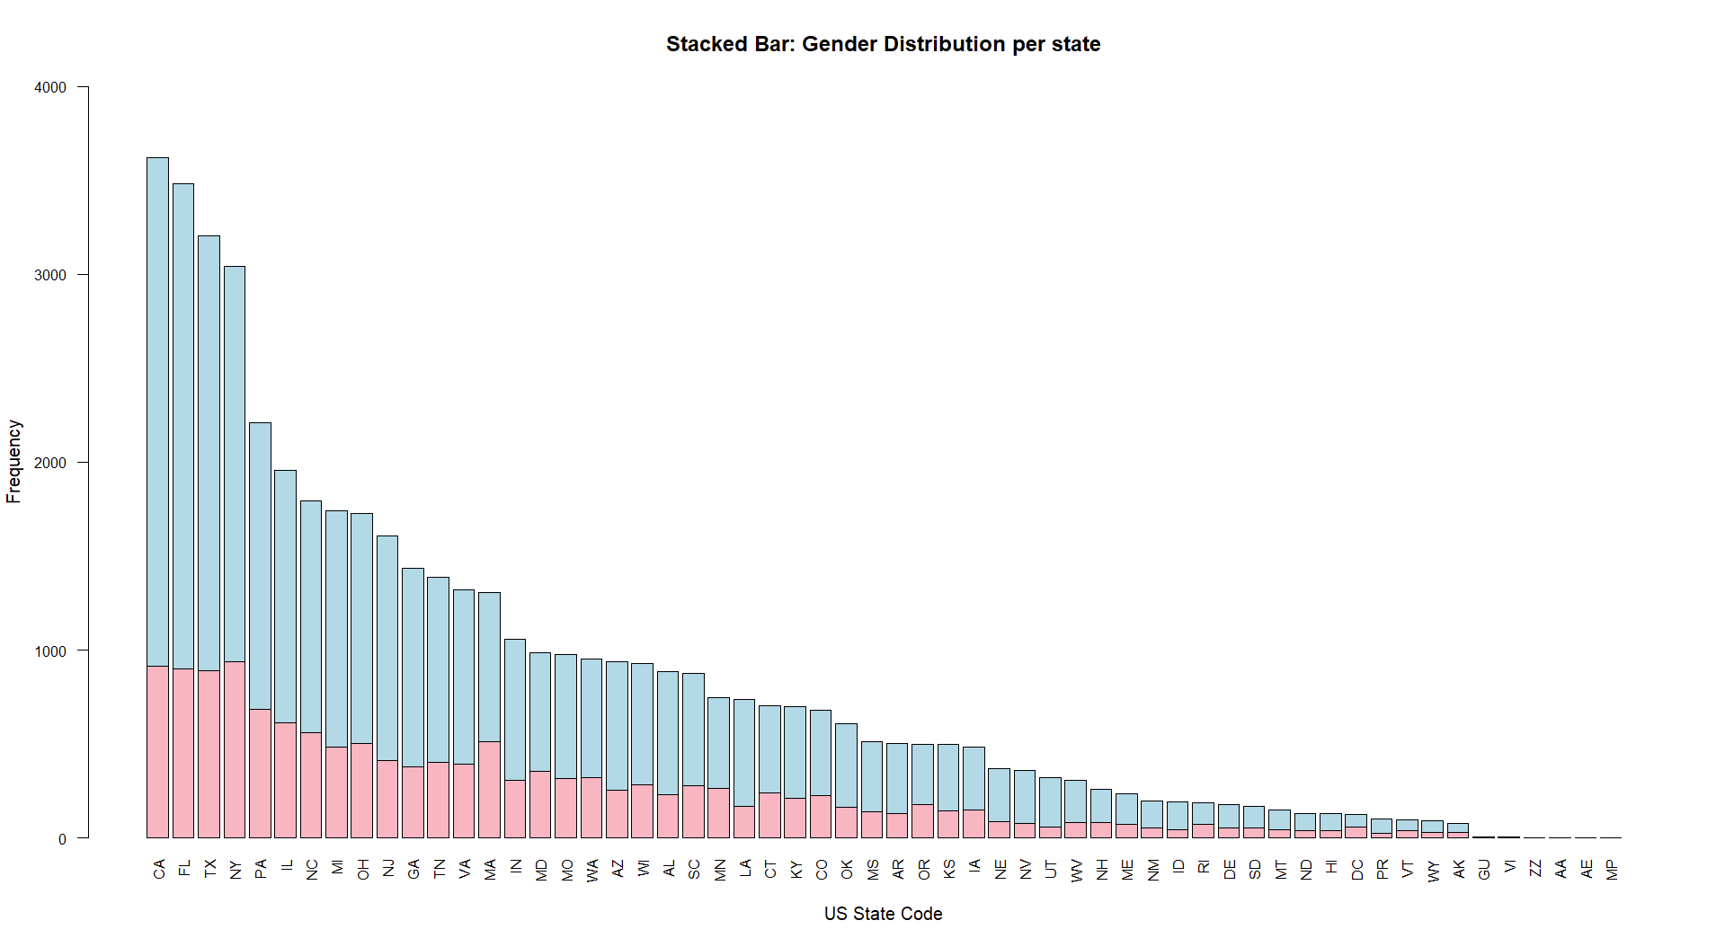
Notes:
<back-up slide not part of presentation>

Slide 20
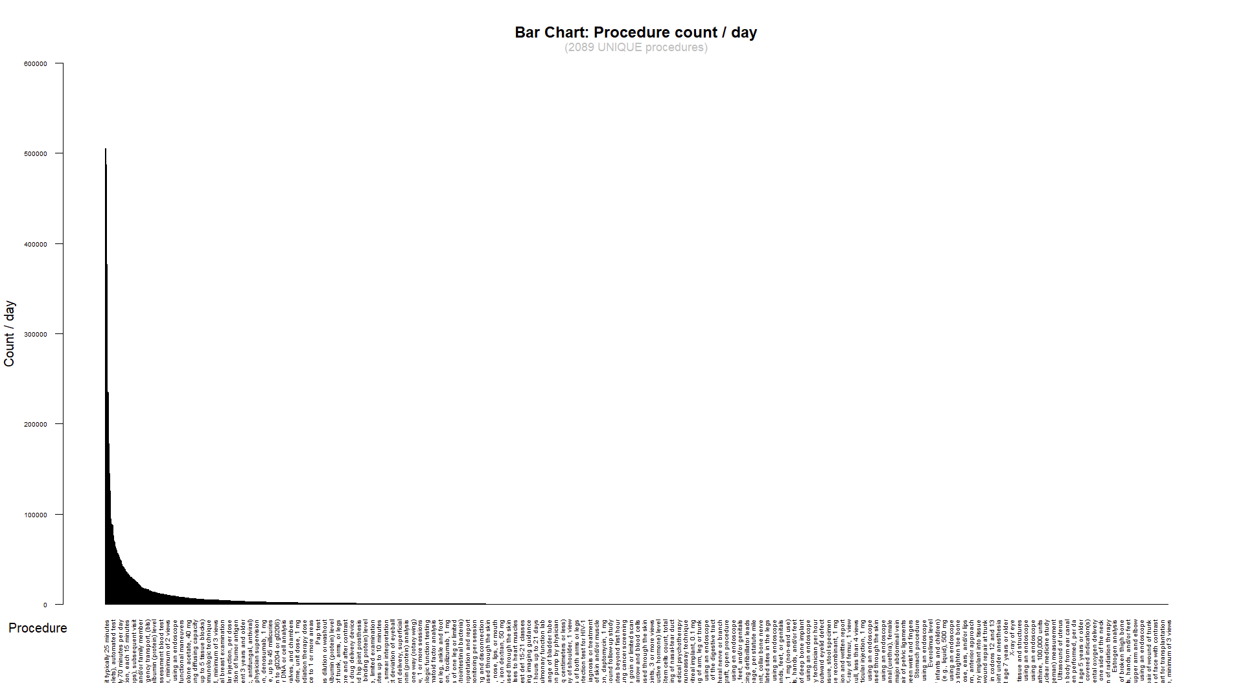
Do female medical providers charge less?
Notes:
<back-up slide not part of presentation> Out of the 50,000 responses, we gathered 2089 Unique procedures which can be seen on the chart

Slide 21

Do female medical providers charge less?
Notes:
<back-up slide not part of presentation> This shows the distribution of the frequency categories.
There only a number or a few procedures on the high frequencies while most procedures are low frequency / day (less than 10k per day, there even procedures at less than 100 per day)

